Slide 1
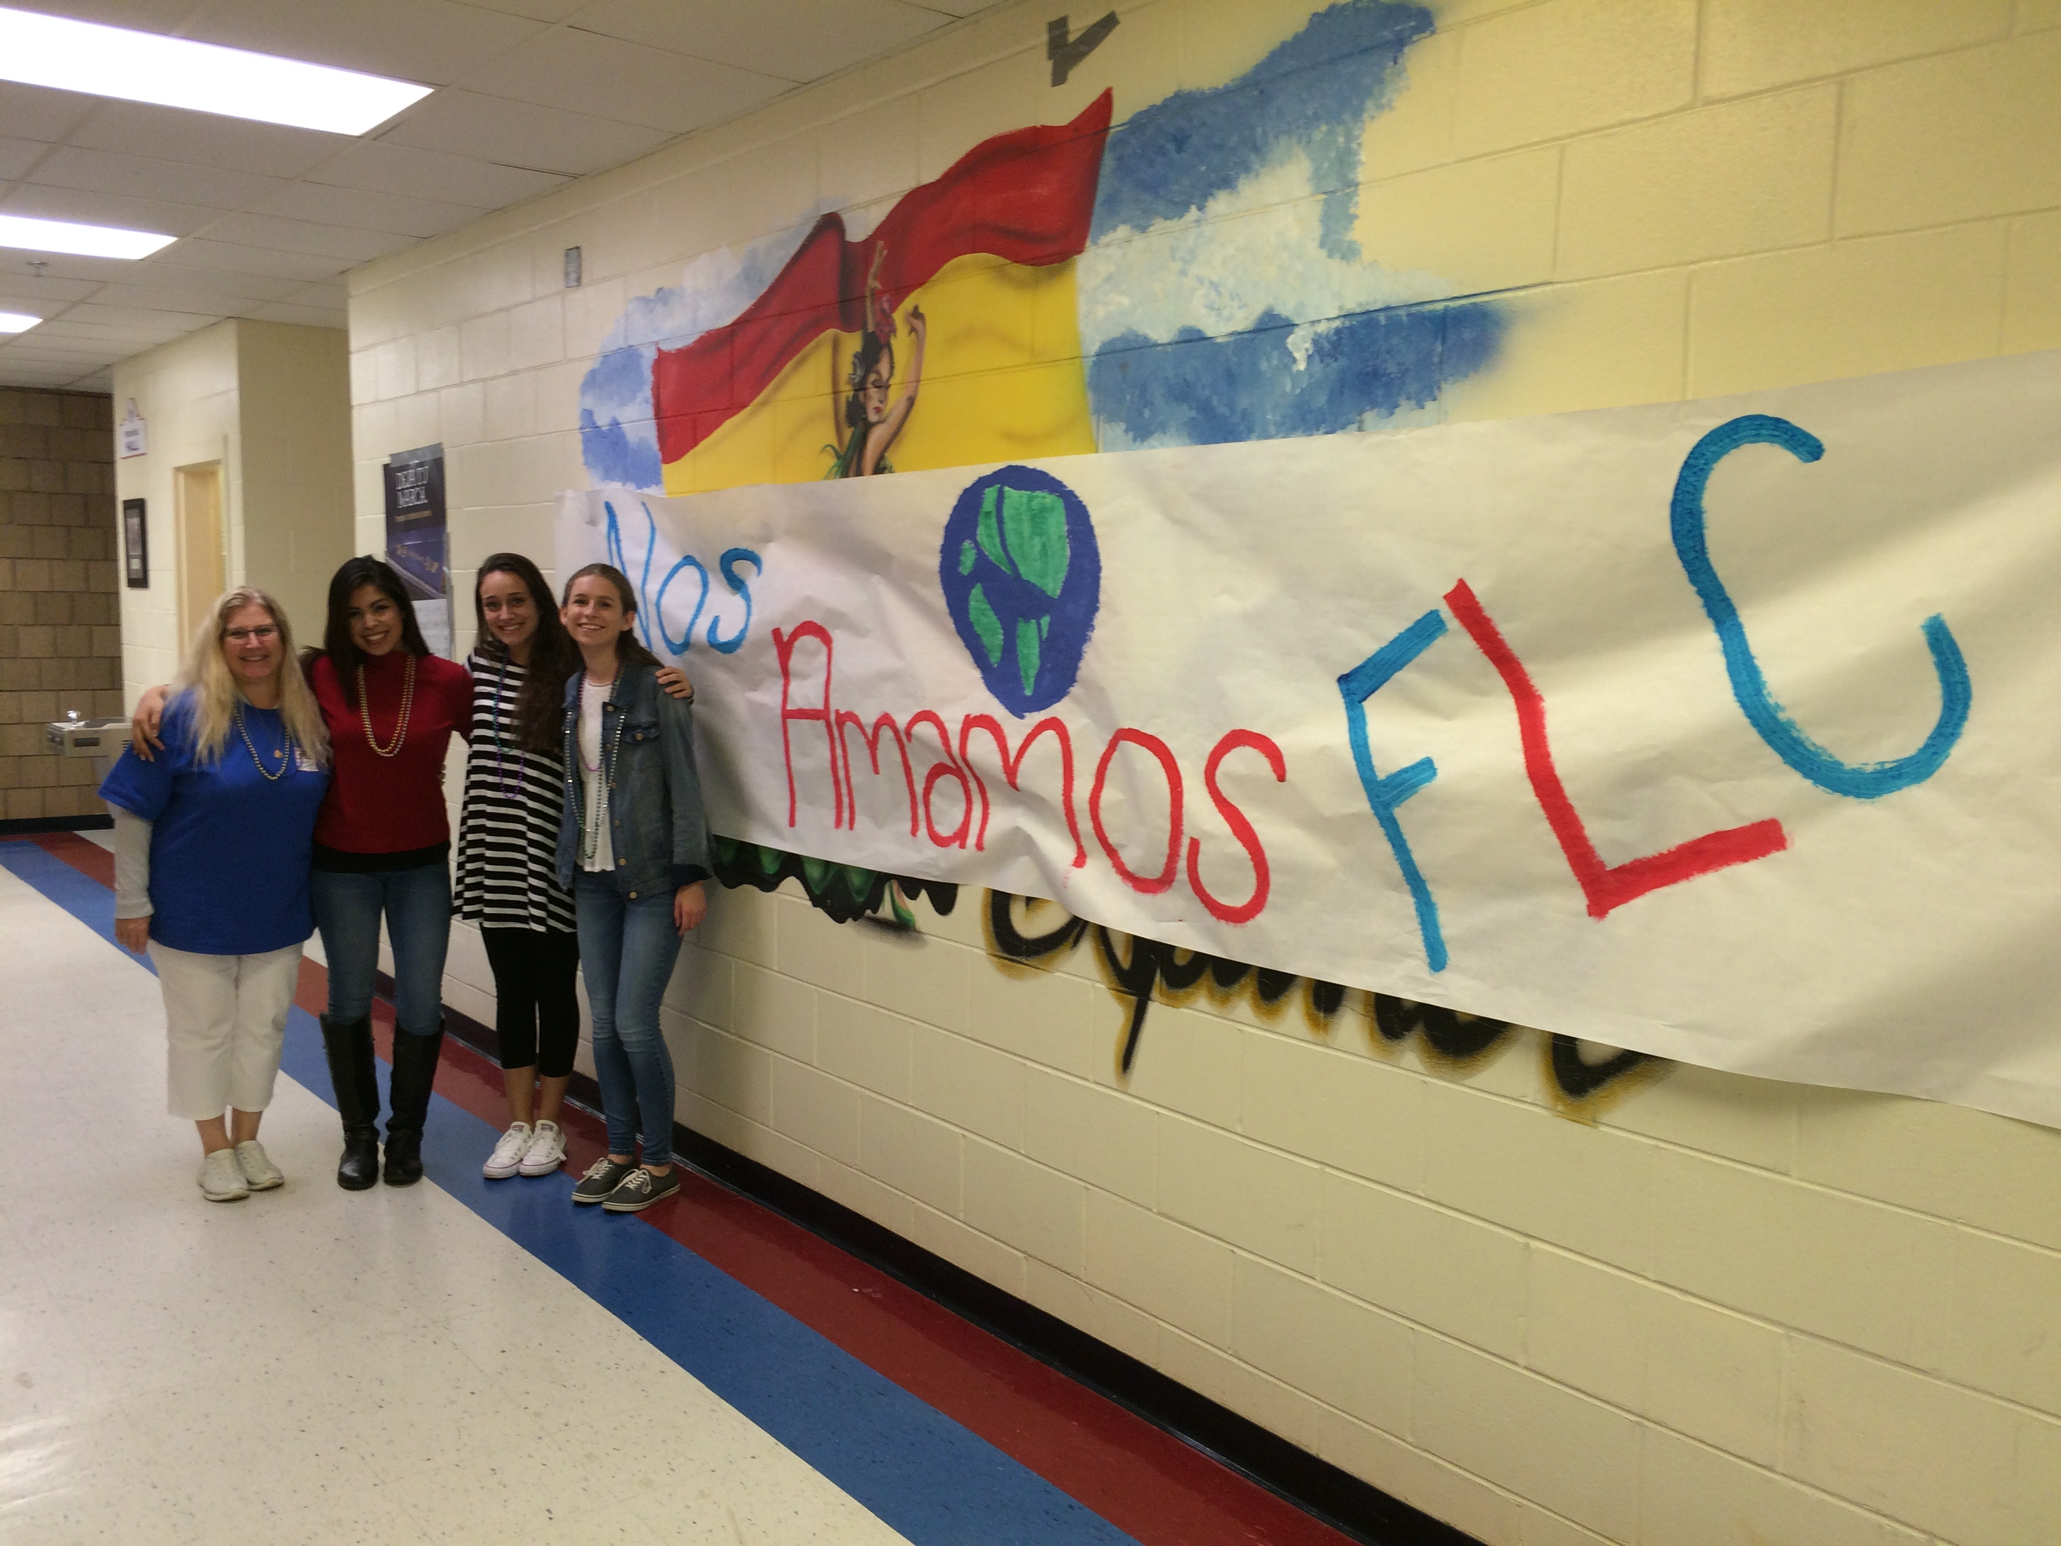
Behind the Scenes: FLC

Slide 2
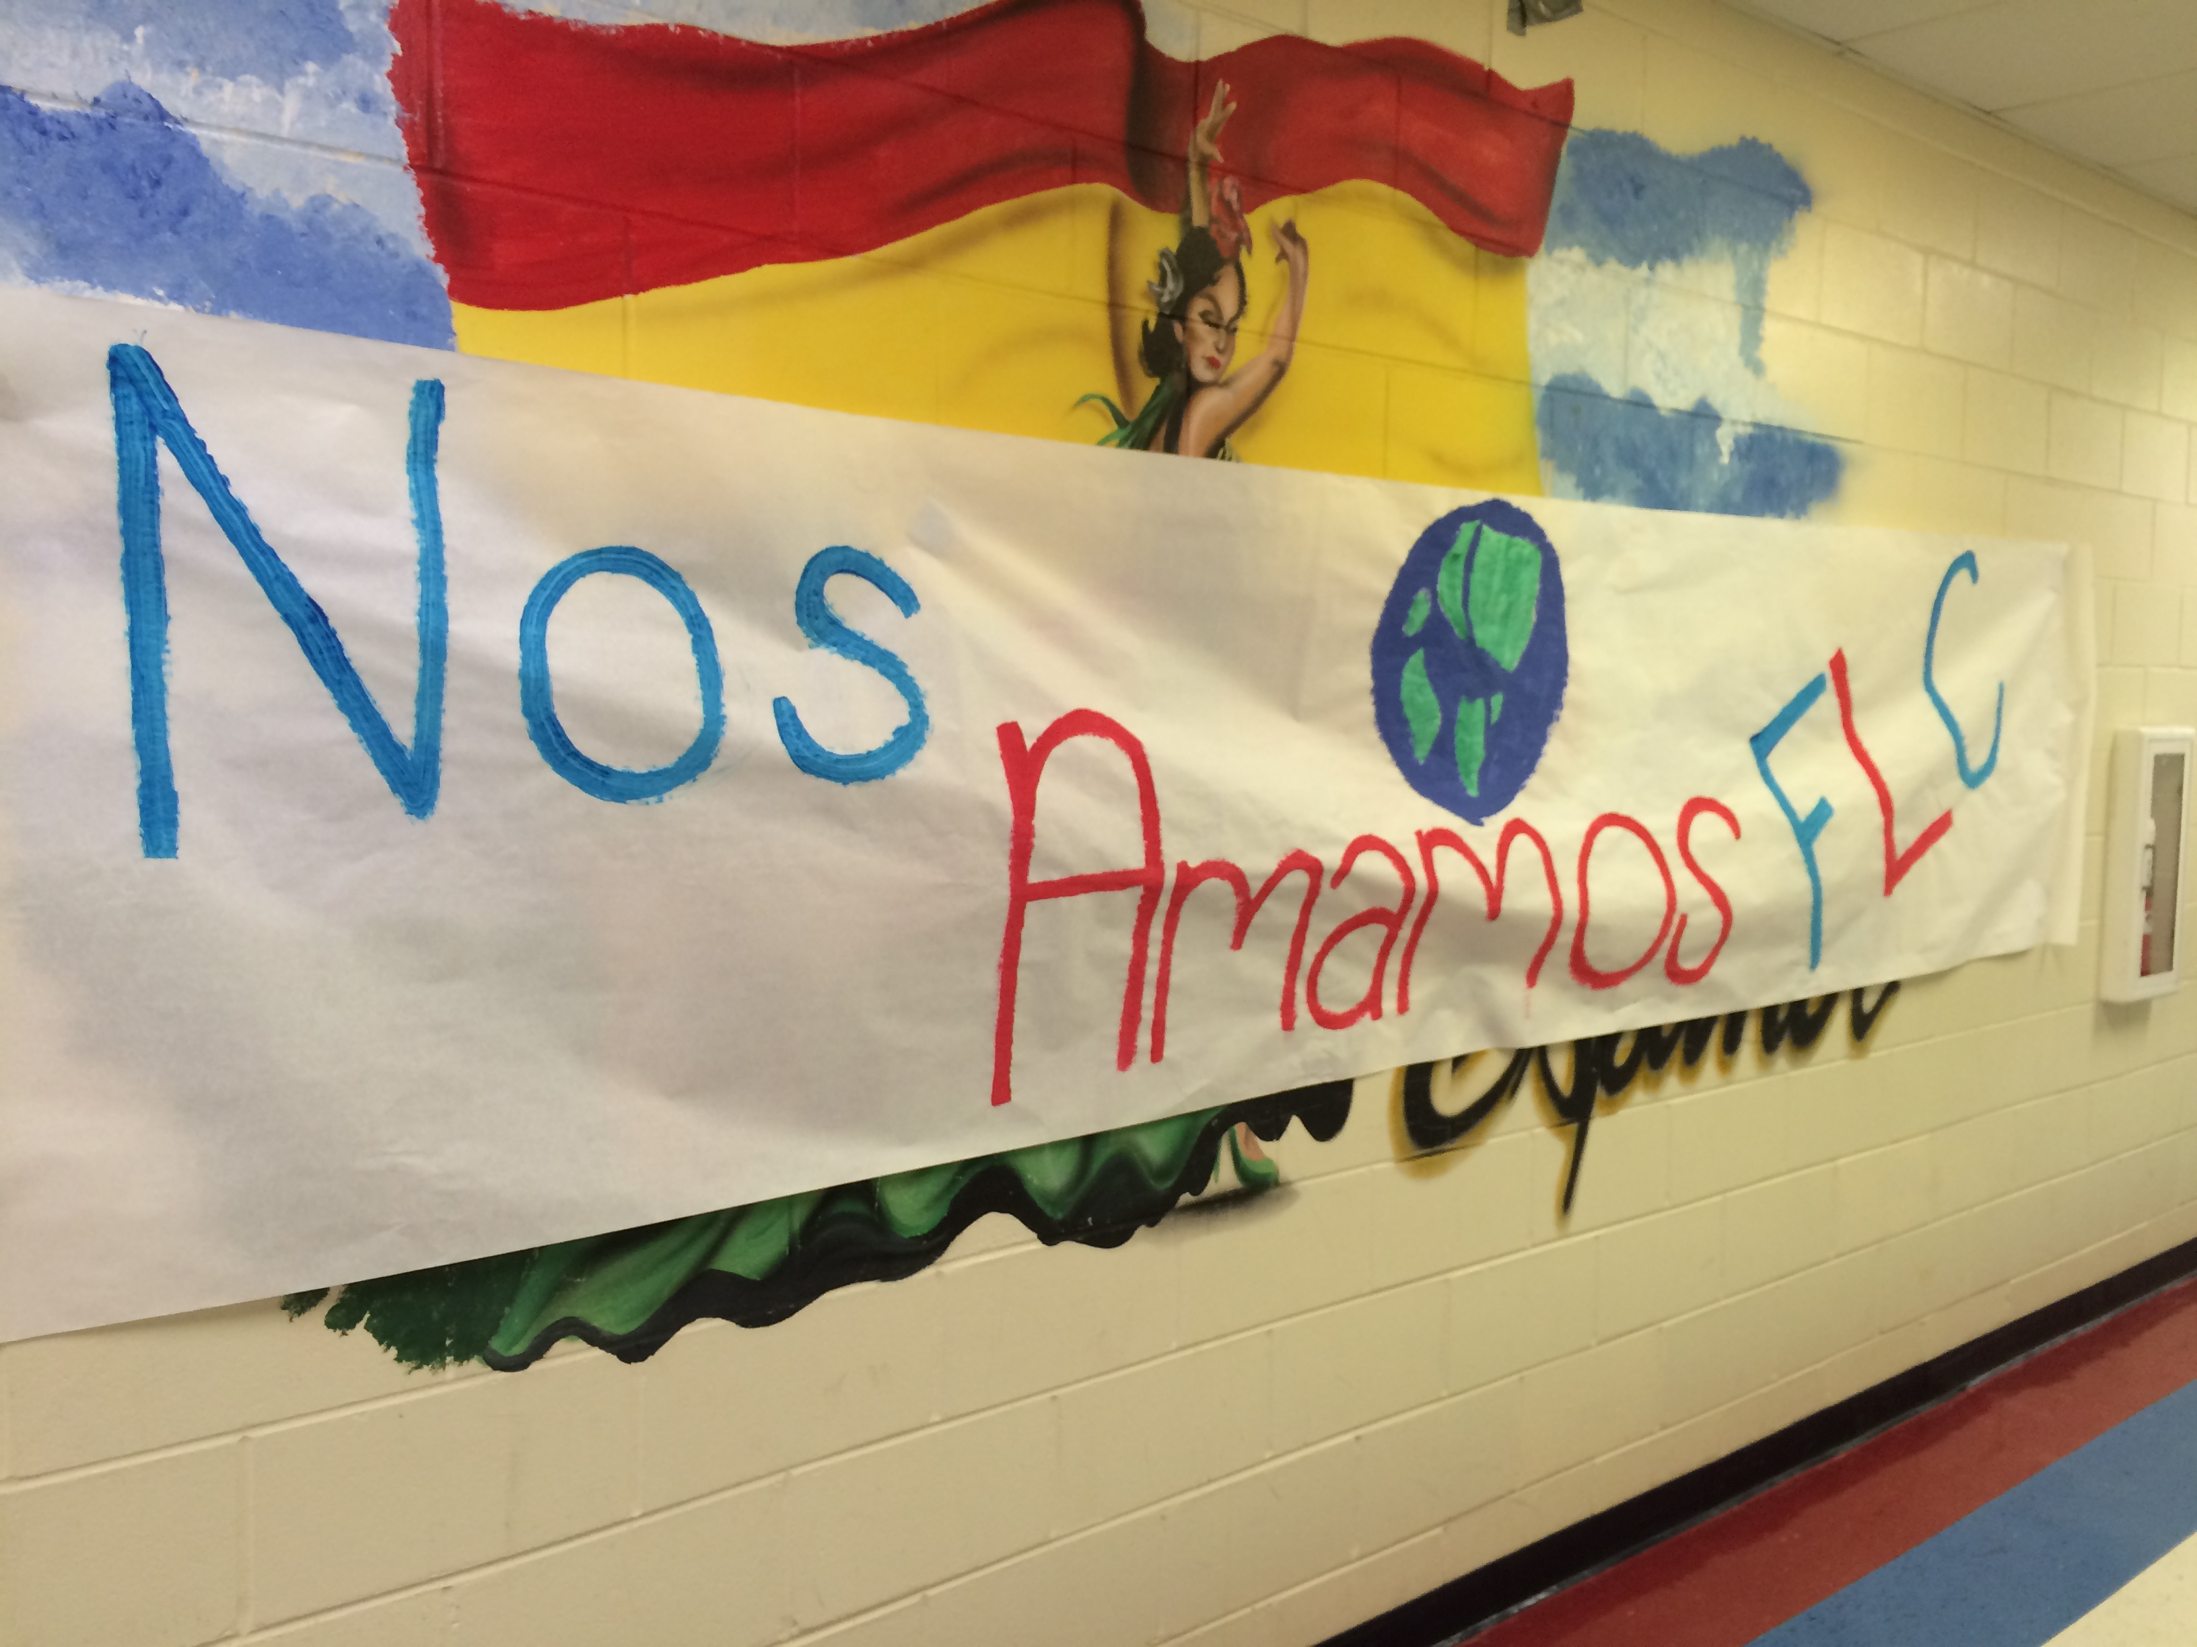
FLC Officers 2015-16
President: Jennifer Cabrera
Vice President: Nathania Torres
Secretary/Historian: Hayley Lavoie
Treasurer: Jordan Goad

Slide 3
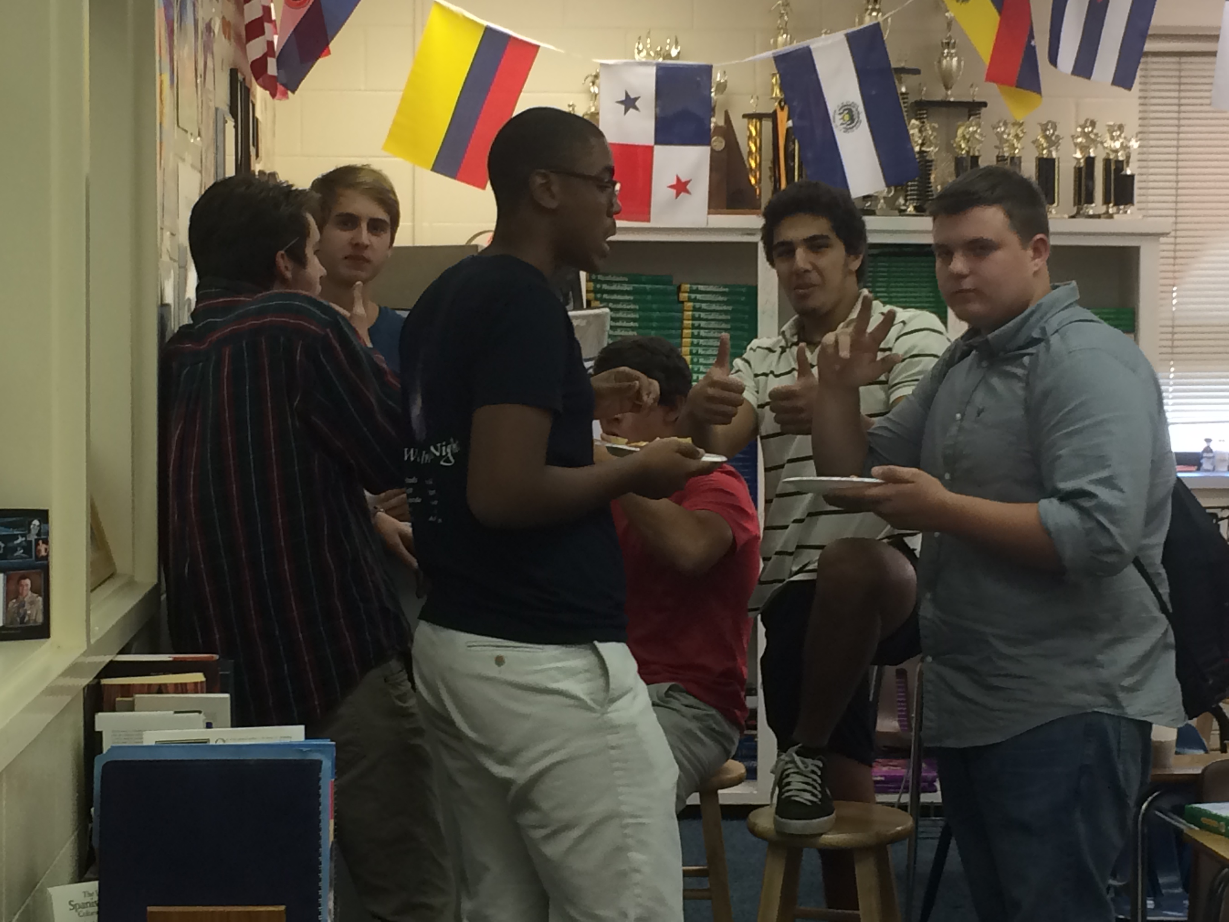
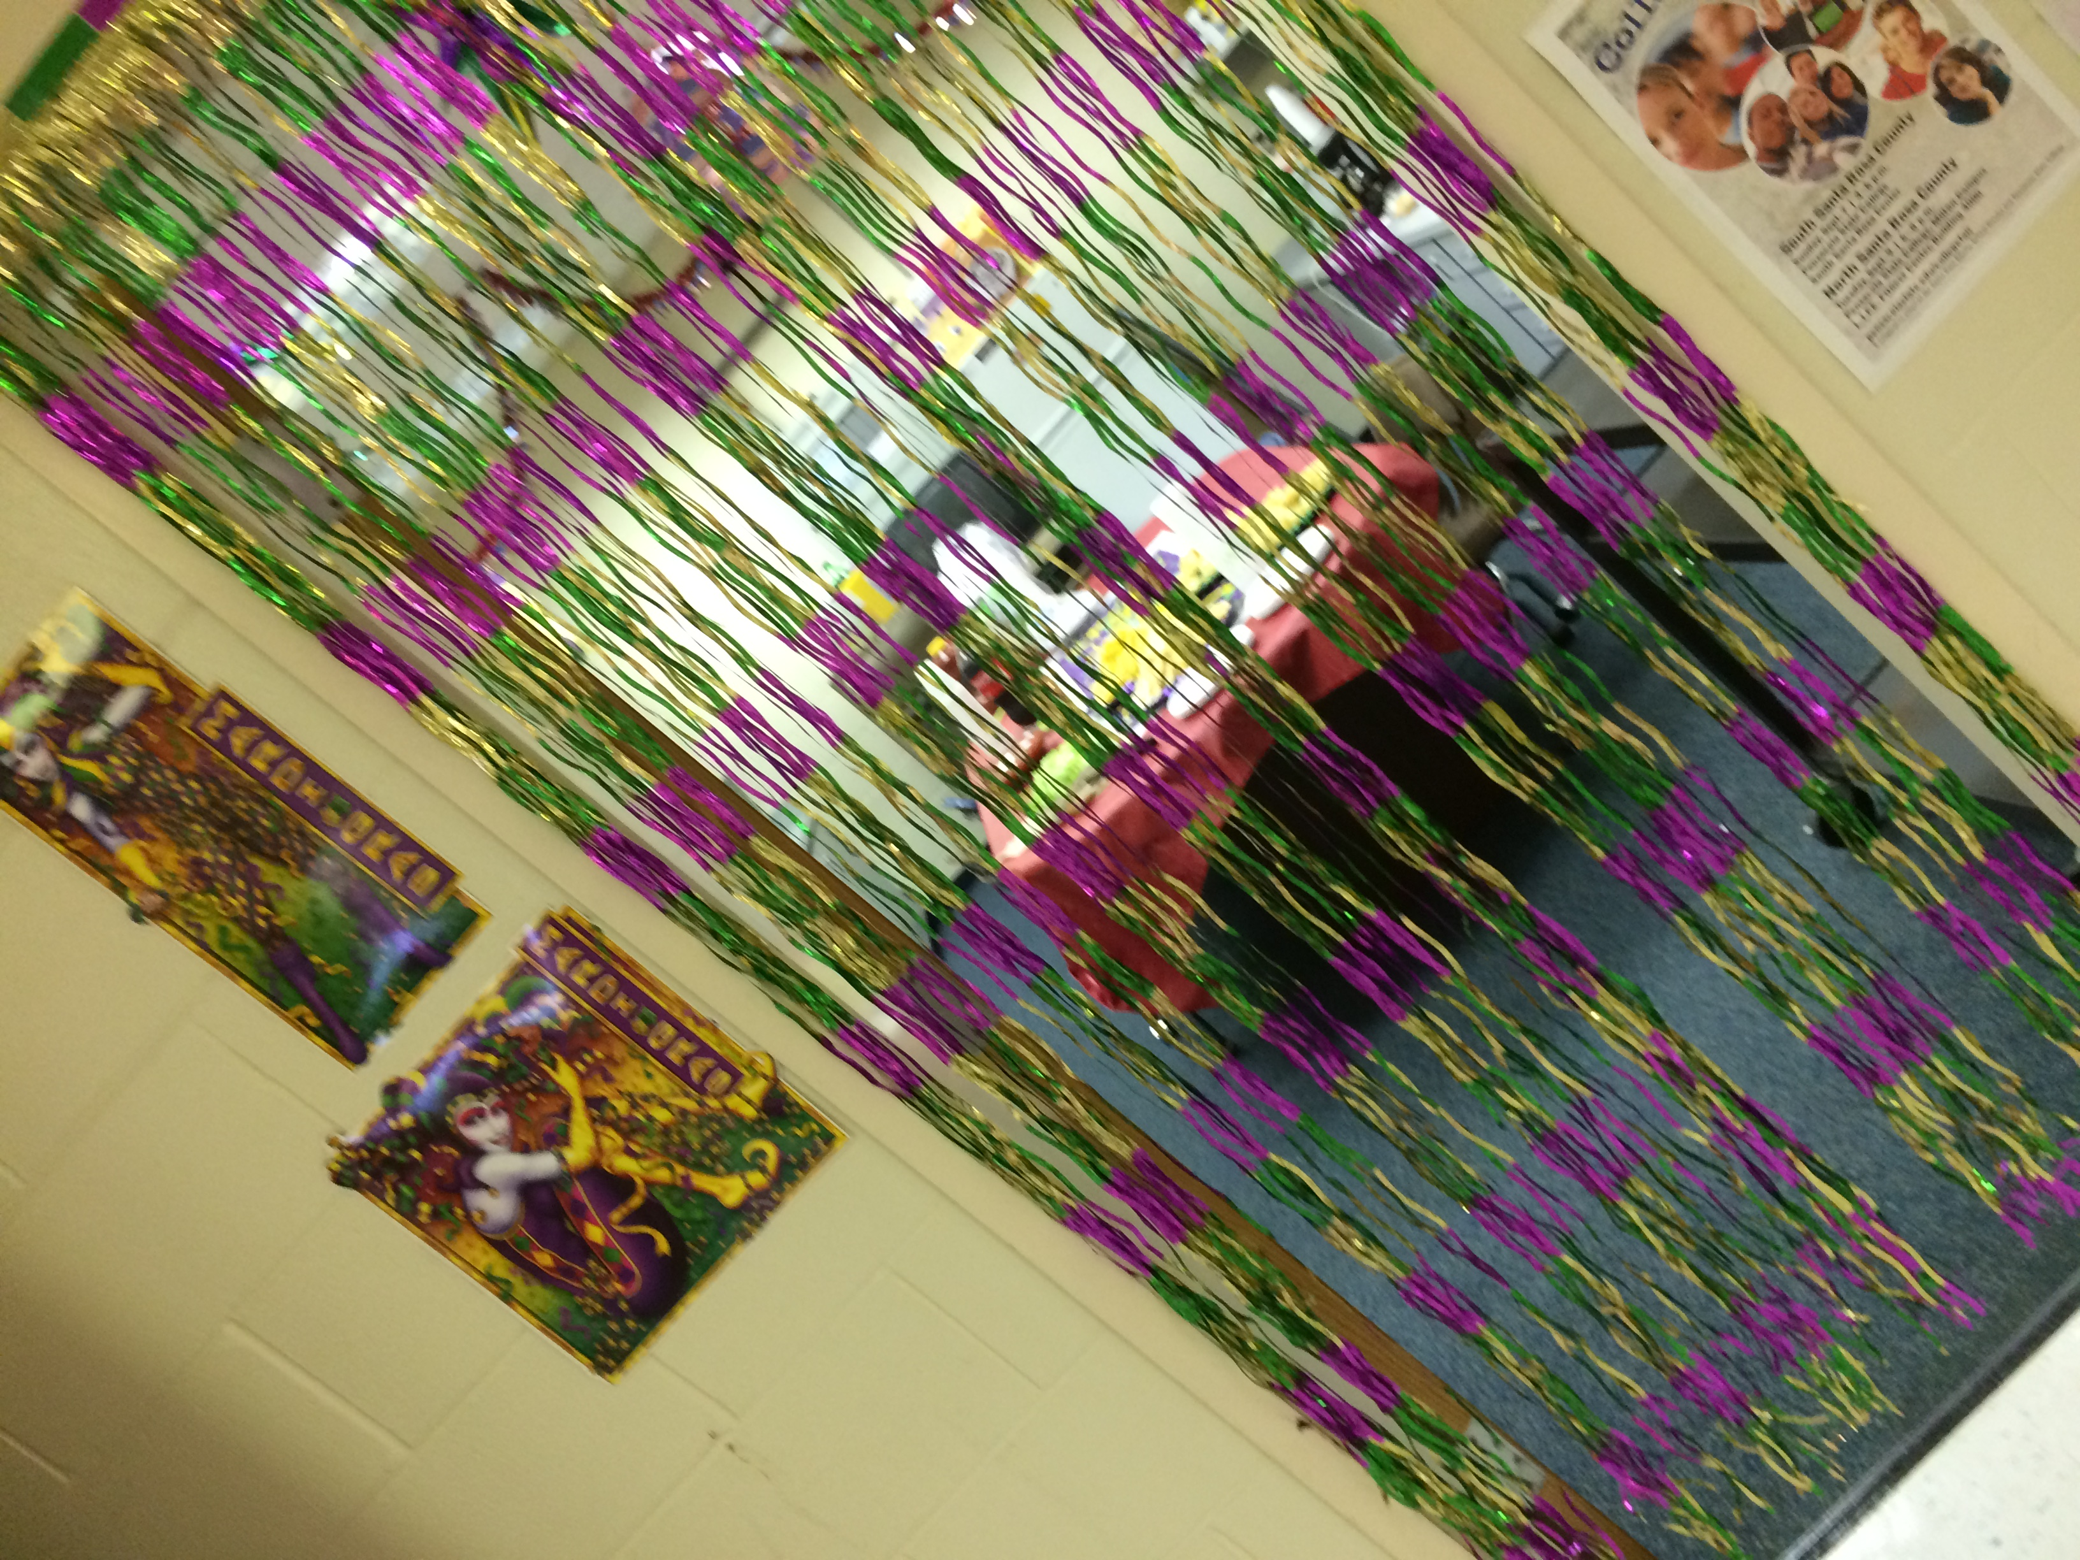
Our Fun Meetings!
The yummy taco bar for Mardi Gras!
(provided by SGA)
Some of the members eating some tasty nachos!
The colorful decor

Slide 4
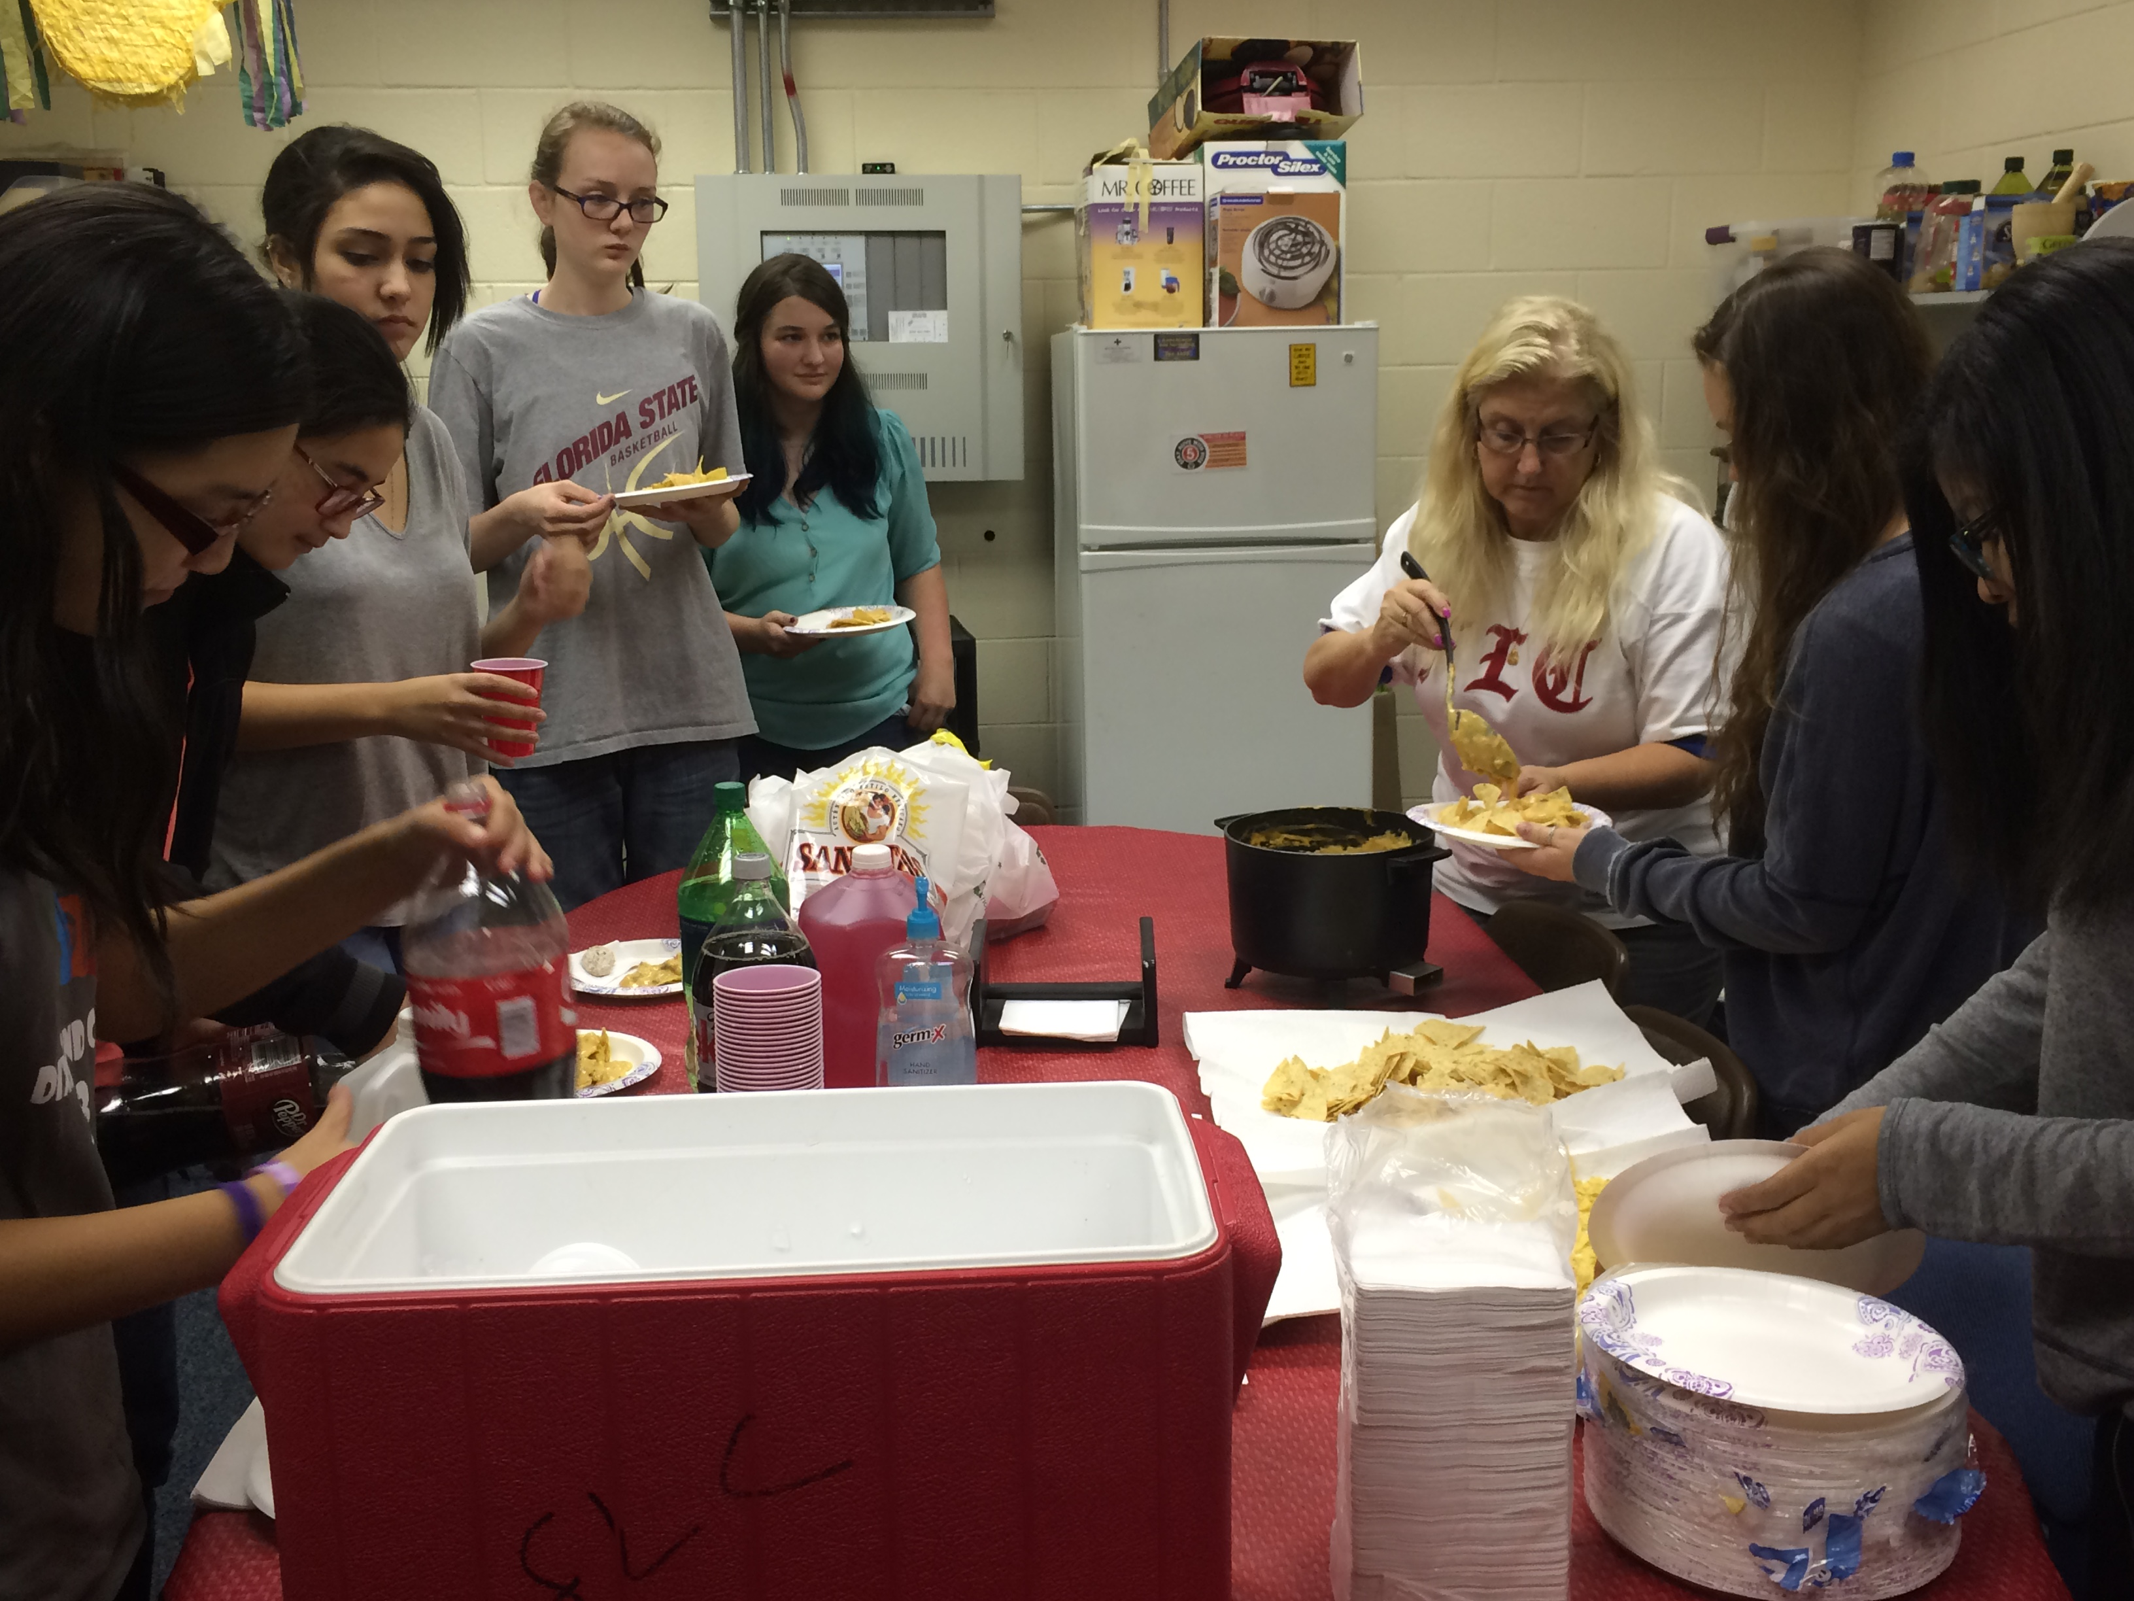
Some More..
Here, members are having fun conversing with friends.
Everyone had to get some of Mrs. Ramirez’s delicious chile con queso!

Slide 5
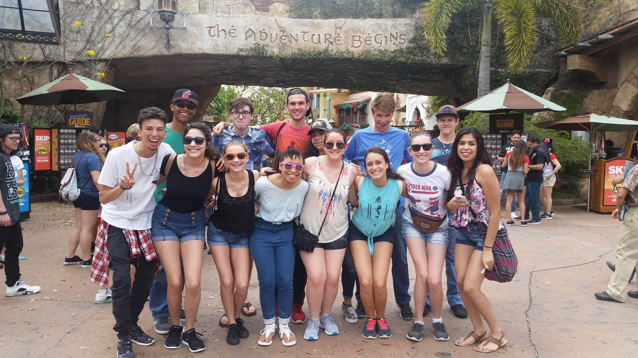
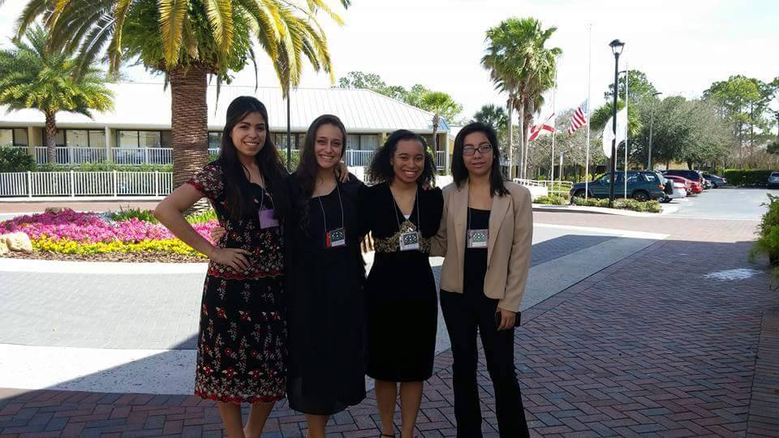
State Competition 2016

Slide 6
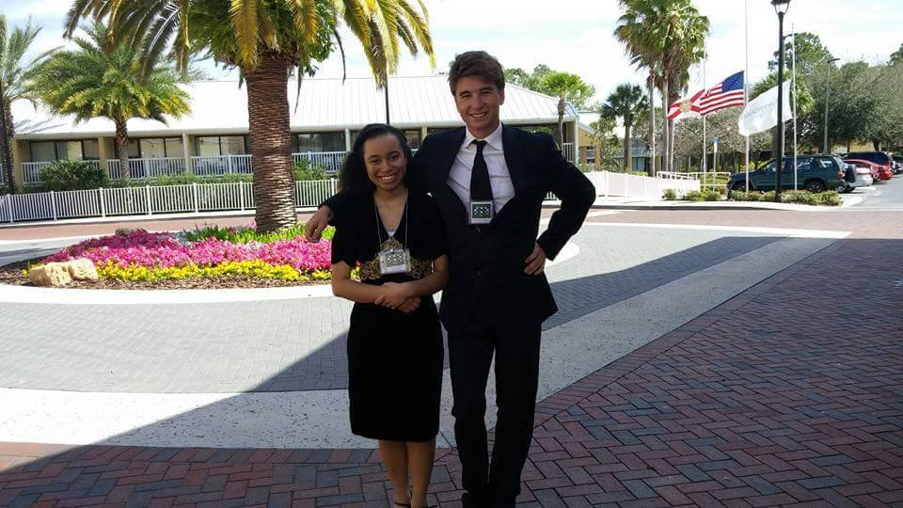
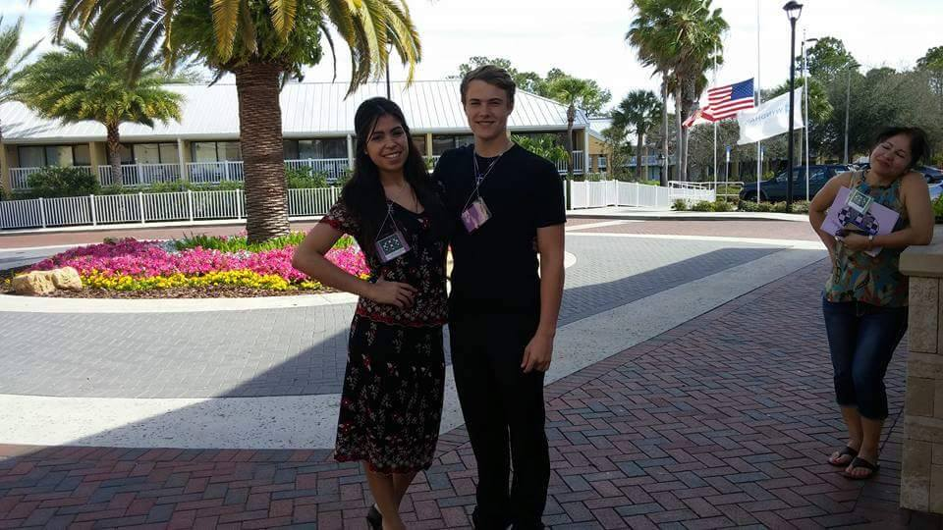
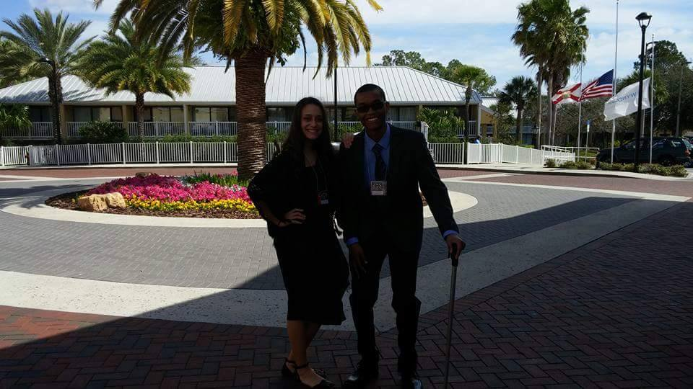
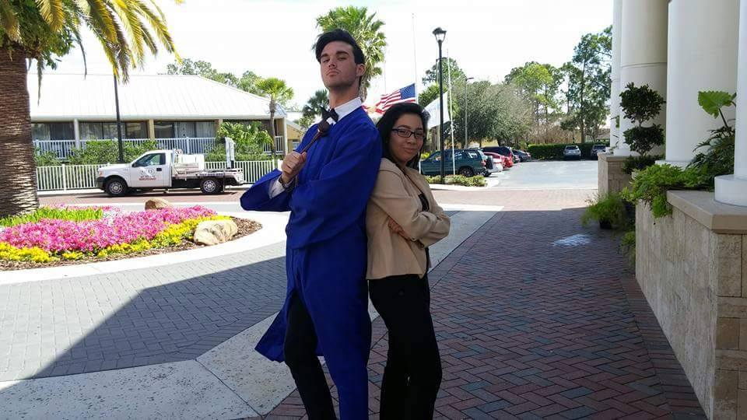
State Competition 2016

Slide 7
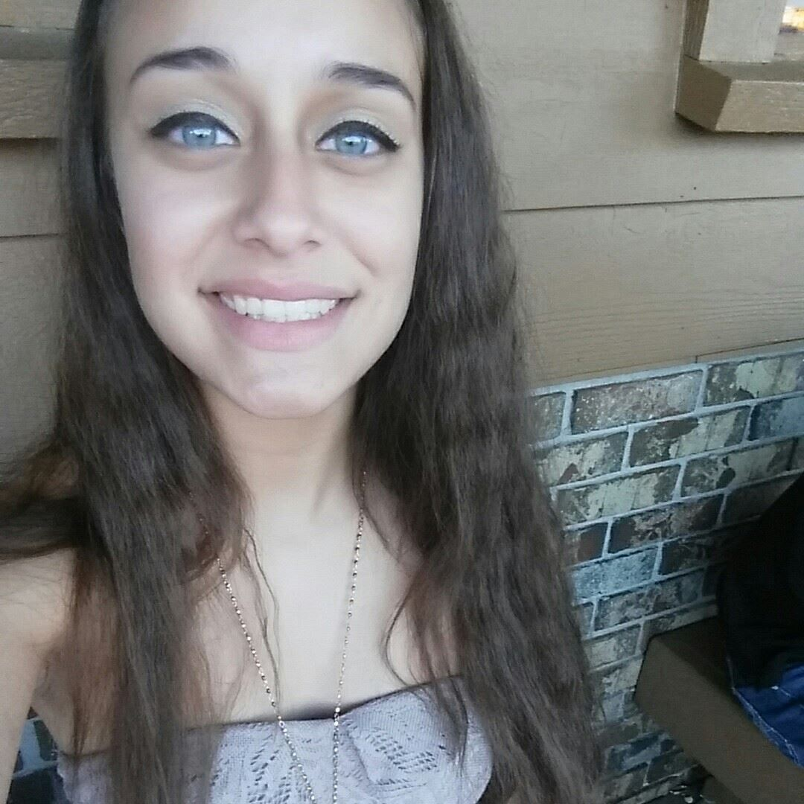
Shout out to our Seniors!!
Jenni and Jordan we love you and wish you the best on your journeys that lay ahead!! <3

Slide 8
Thank You
A huge thank you to every member for making this year’s FLC meetings amazing! This club wouldn’t be here if it wasn’t for our lovely members and wonderful officers. Also, a huge shout out to our amazing leaders/sponsors, Mrs. Ramirez, Mrs. Trew, and Mrs. Corraliza. Thank you for cooking, helping, and pushing us to obtain our goals. We hope everyone has a great summer, and for the seniors out there we wish you lots of luck and success on your future that lays ahead!

